Slide 1

LIBRARY MANAGEMENT SYSTEM
CHALLENGERS TEAM
Presented by: Submitted To
  K.Keerthi Mr.Arjun
  H.Rajini (Besant tech)
  SK.Nageena
  B.Radha
  C.Bindu

Slide 2

What is SQL? Why it is used?
SQL stands for Structured Query Language
SQL is used to communicate with a
database.
SQL lets us access and manipulate databases.

Slide 3
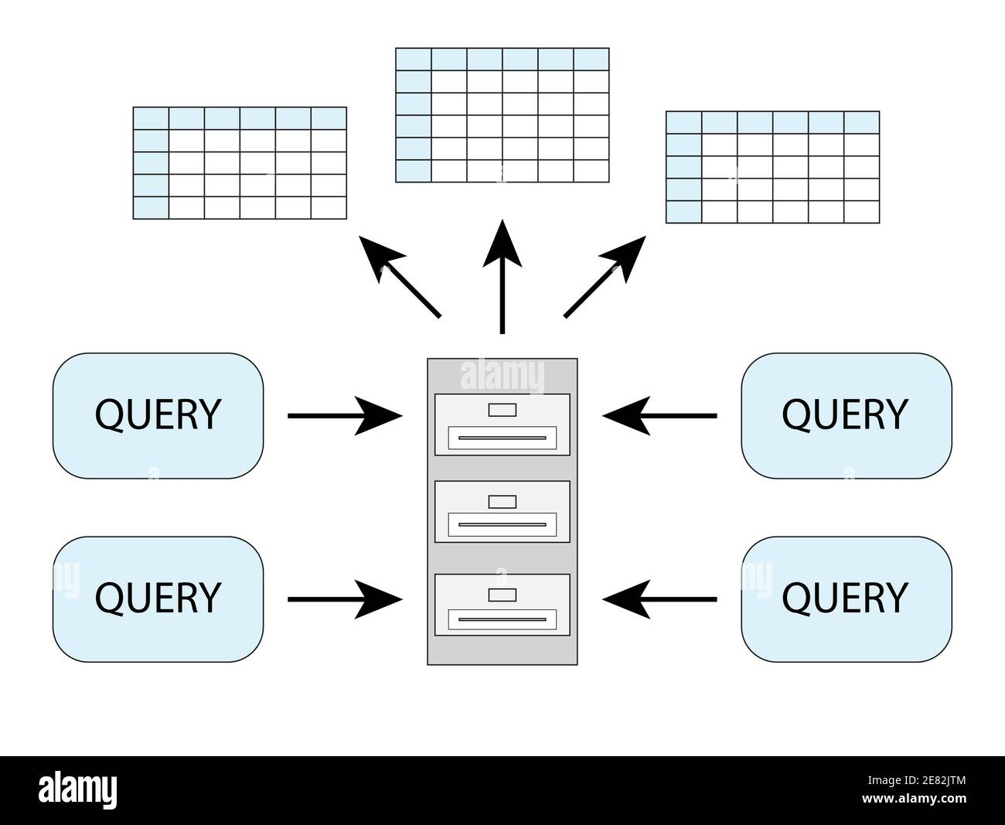
What is query????
In Database, a query is a request made to retrieve, modify or delete data from a database.
It is a specific instruction given to a database management system (DBMS) that defines a set of criteria to search for and retrieve the desired data.

Slide 4

What is library management system??
A library management system is software that is
designed to manage all the functions of a library.
It helps librarian to maintain the database of new books and the books that are borrowed by members along with their due dates.

Slide 5

DBMS in Library Management System
Maintaining Book Data
Count no. of copies available for each book
Easy Book Search
Penalty for return due
Book return due

Slide 6
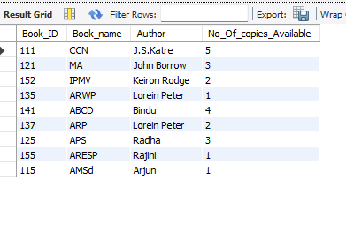
Book_Details:

Slide 7
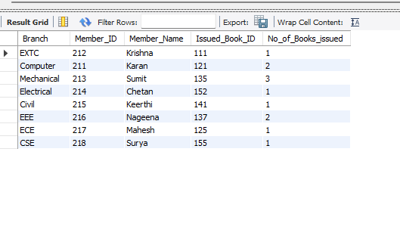
Student_Detail:

Slide 8
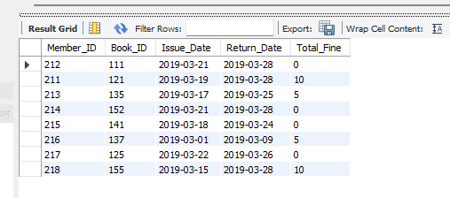
Library_Detail:

Slide 9
E-R Diagram:
An Entity Relationship Diagram is a diagram that represents relationships among entities in a database. It is commonly known as an ER Diagram.
An ER Diagram in DBMS plays a crucial role in designing the database. Today’s business world previews all the requirements demanded by the users in the form of an ER Diagram.
Later, it's forwarded to the database administrators to design the database.

Slide 10
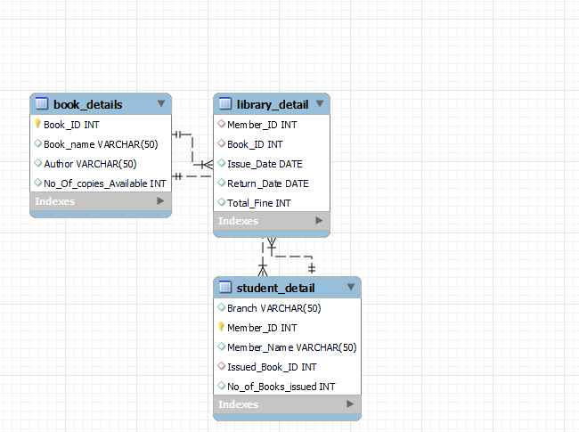
E-R Diagram for library management system:

Slide 11
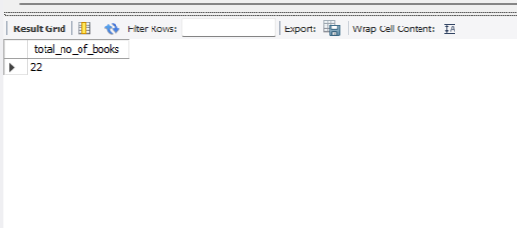
Q1)Write a query to display total number books available in library .
Query:
Select sum( No_Of_copies_Available) as total_no_of_books from Book_Details;
Output:

Slide 12
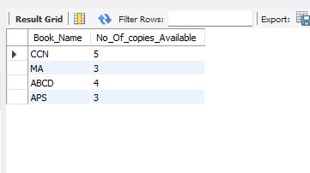
Q2)Write a query to display all book names where more than 2 copies should be available.
Query:
Select Book_Name , No_Of_copies_Available from Book_details where No_Of_copies_Available>2;
Output:

Slide 13
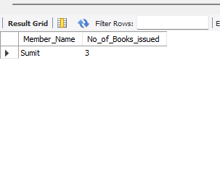
Q3)Write a query to display total member names who have taken more than 2 books.
Query:
select Member_Name , No_of_Books_issued from Student_Detail where No_of_Books_issued>2;
Output:

Slide 14
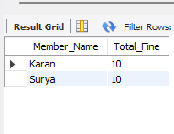
Q4)Write a query to display total member names who have paid fees more than 5rupees.
Query:
Select Student_Detail.Member_Name ,Library_Detail.Total_Fine from Student_Detail inner join Library_Detail on Student_Detail.Member_ID = Library_Detail.Member_ID where Library_Detail.Total_Fine>5;
Output:

Slide 15
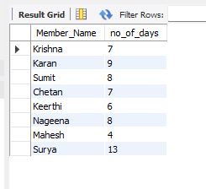
Q5)Write a query to display student name and no of days they returned book.
Query:
Select Student_Detail.Member_Name,
datediff(Return_Date,Issue_date) from Student_Detail inner join Library_Detail on Student_Detail.Member_ID=Library_Detail.Member_ID;
Output:

Slide 16
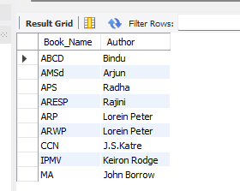
Q6)Write a query to display book name and author name and order the books by alphabetical order of book names
Query:
Select Book_Name, Author from Book_Details order by Book_Name asc;
Output:

Slide 17
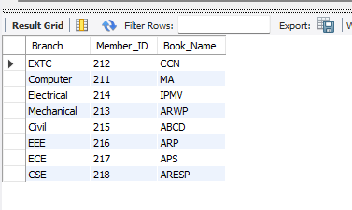
Q7)Write a query to display respective branch and member id and
Book name.
Query:
select Branch , Member_ID , Book_Name from Student_Detail
Inner join Book_Details on
Student_Detail.Issued_Book_ID = Book_Details.Book_ID;
Output:

Slide 18
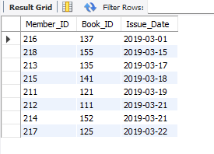
Q8) write query to display Member_ID , Book_ID, Issue_Date display in sorted order of issue_date.
Query:
select Member_ID, Book_ID, Issue_Date from Library_Detail order by Issue_date;
Output:

Slide 19
REFERENCES:
https://github.com/
https://www.w3schools.com/sql/default.asp
https://www.tutorialspoint.com/sql/sql-overview.htm
https://www.geeksforgeeks.org/sql-tutorial/

Slide 20
Thank You

